Slide 1
Protein and its Structures

Slide 2
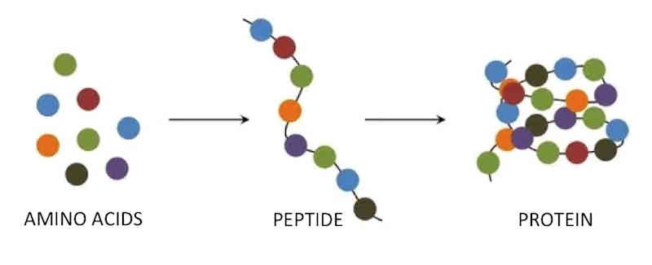
Amino acid: Basic unit of protein
Amino acids are Building block of Proteins
R
NH₃⁺
C
COO⁻
Different side chains, R, determine the properties of 20 amino acids.
Amino group
Carboxylic acid group
H
An amino acid

Slide 3
20 Amino acids

Slide 4
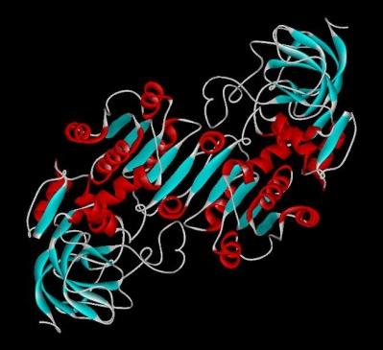
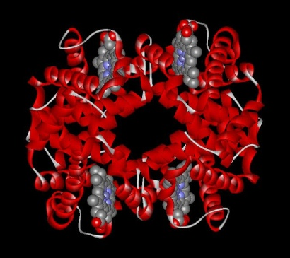
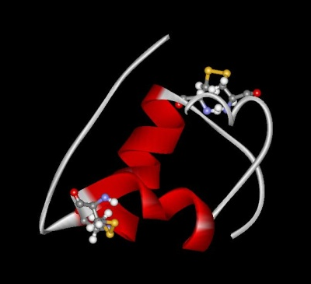
Protein Functions
Alcohol dehydrogenase oxidizes alcohols to aldehydes or ketones
Three major functions of protein are,
Catalysis: Almost all chemical reactions in a living cell are catalyzed by protein enzymes.
Transport: Some proteins transports various substances, such as oxygen, ions, and so on.
Information transfer: For example, hormones.
Haemoglobin carries oxygen
Insulin controls the amount of sugar in the blood

Slide 5
Shapes & Sizes
There are more varieties of P’s in a cell than any other macromolecule
Filamentous & Globular
Large & Small

Slide 6
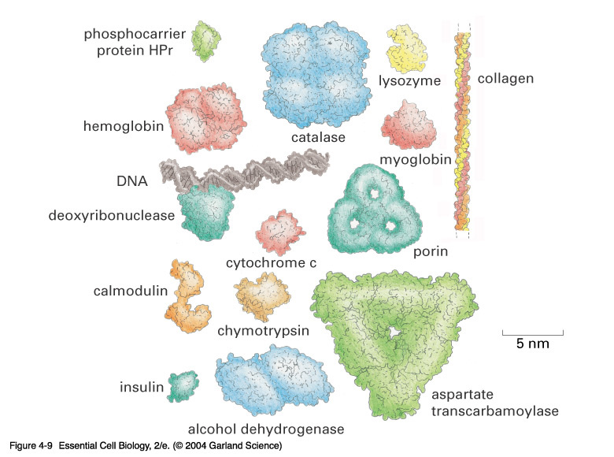

Slide 7
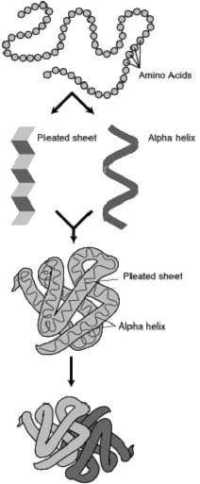
Protein Structure
Primary
Secondary
Tertiary
Quaternary
Assembly
Folding
Packing
Interaction
S T R U C T U R E
P R O C E S S

Slide 8
Hierarchical nature of protein structure
Primary structure (Amino acid sequence)
↓
Secondary structure （α-helix, β-sheet）
↓
Tertiary structure （Three-dimensional structure formed by assembly of secondary structures）
↓
Quaternary structure （Structure formed by more than one polypeptide chains）

Slide 9
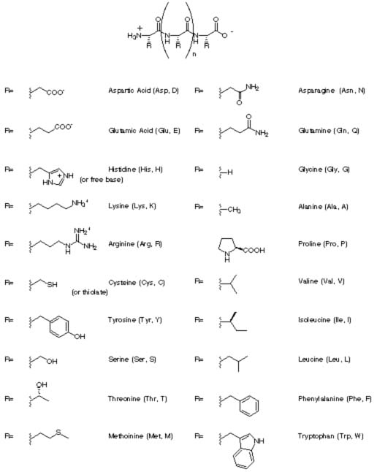
Primary Structure
linear
ordered
1 dimensional
sequence of amino acid polymer
by convention, written from amino end to carboxyl end (N-termainal to C-terminal)
a perfectly linear amino acid polymer is neither functional nor energetically favorable → folding!
Eg. Silk fibroin

Slide 10
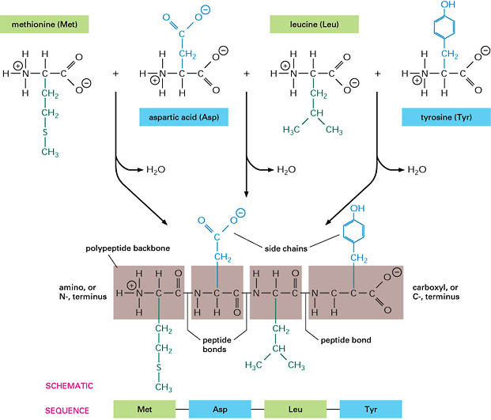
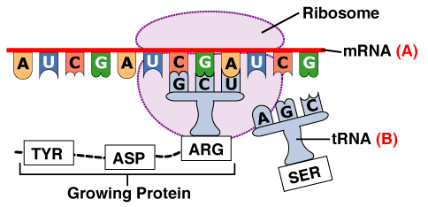
Protein Assembly
Occurs at the ribosome
Involves polymerization of amino acids attached to tRNA
Yields primary structure

Slide 11
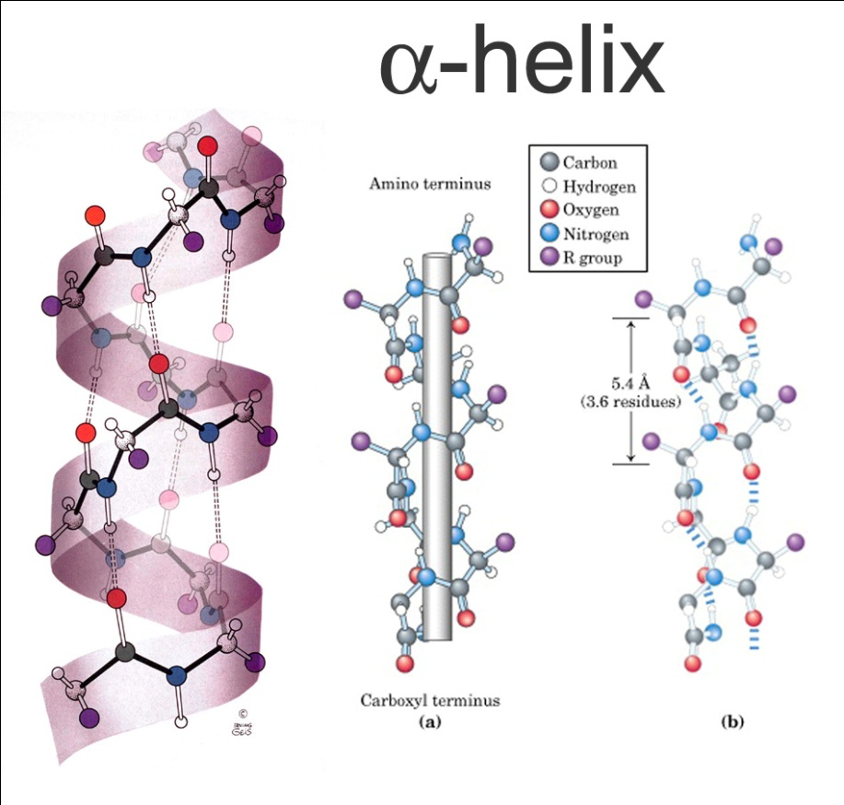
Secondary Structure
Non-linear
3 dimensional
Localized to regions of an amino acid chain
Formed and stabilized by hydrogen bonding, electrostatic and van der Waals interactions

Slide 12
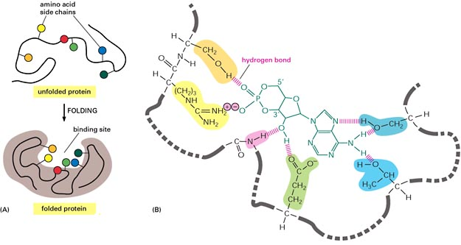
Protein Folding
Occurs in the cytosol
Involves localized spatial interaction among primary structure elements, i.e. the amino acids
Yields Secondary structure

Slide 13
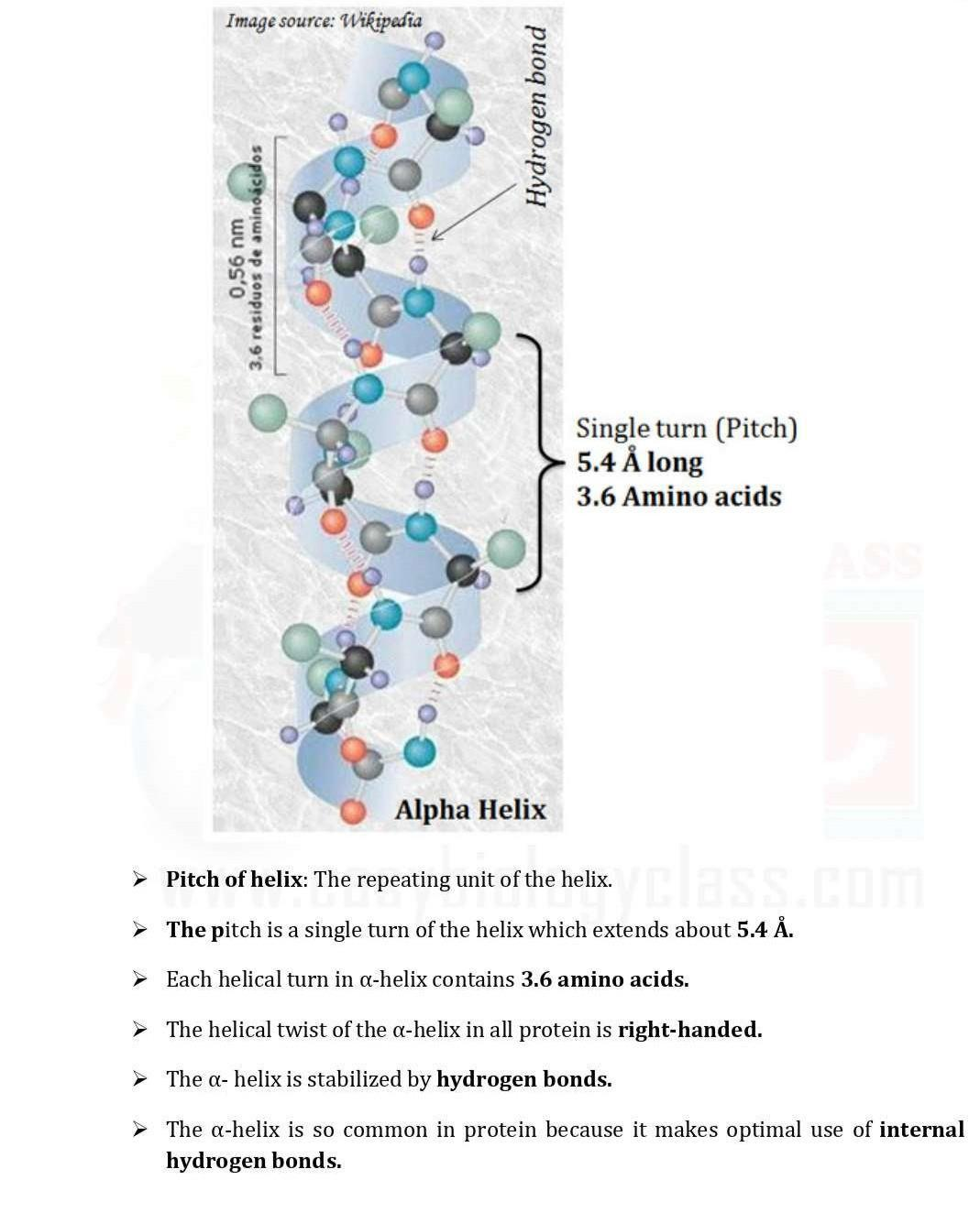
α - Helix

Slide 14
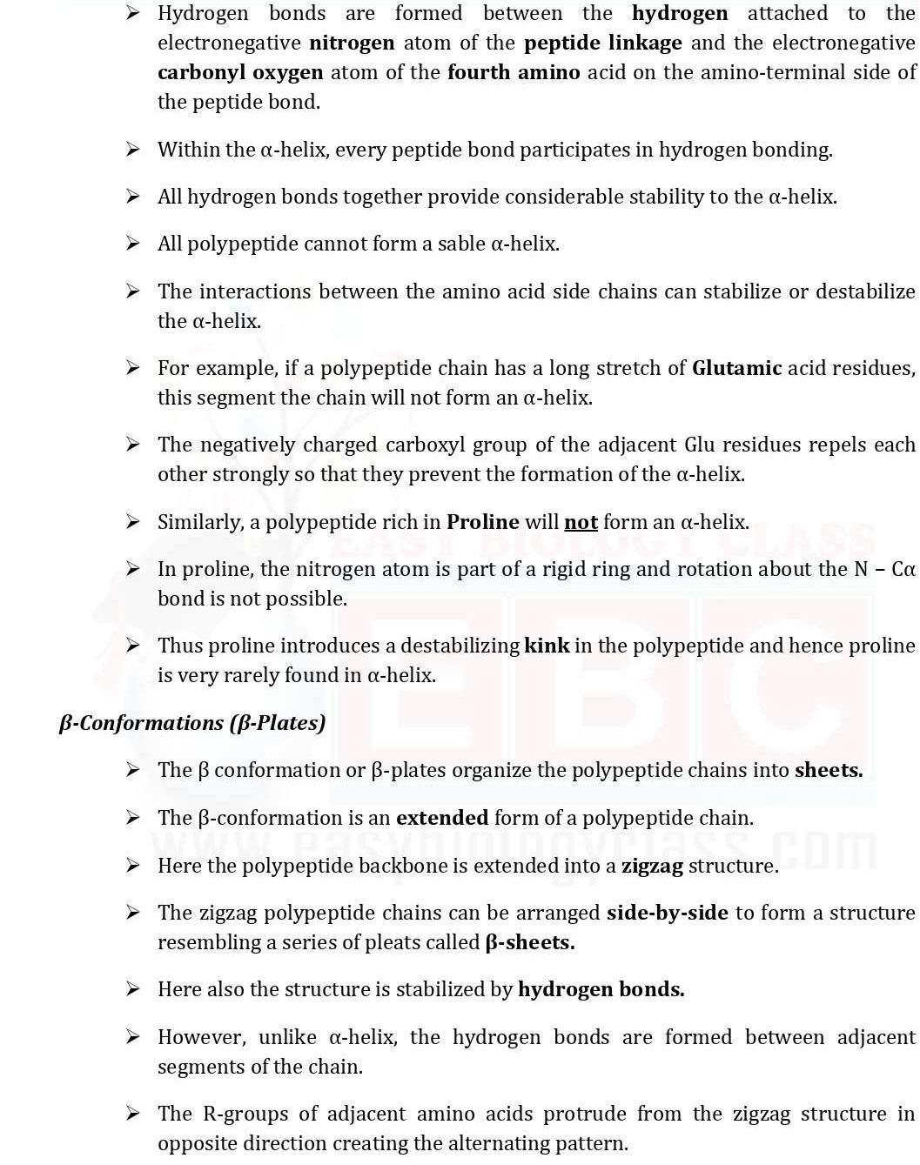
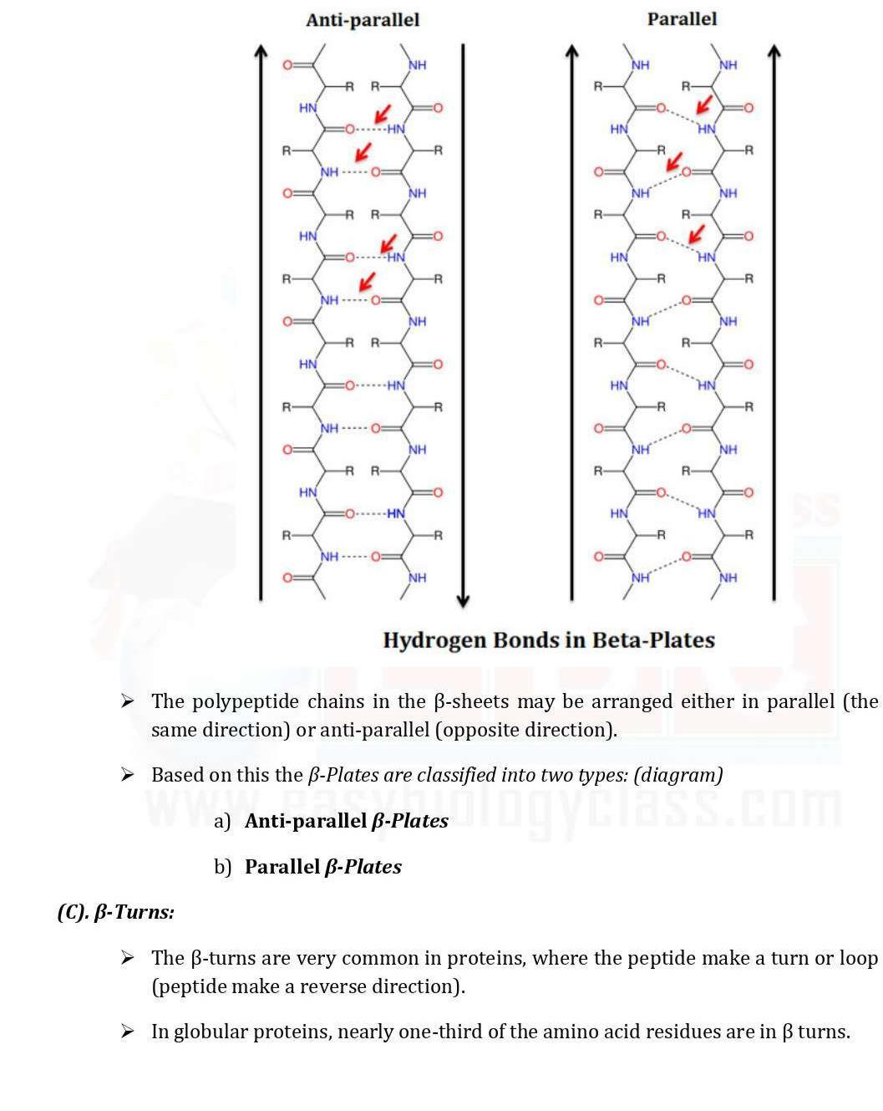

Slide 15
Eg. Muscle
Eg. Keratin of wool

Slide 16
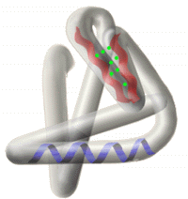
Tertiary Structure
Non-linear
3 dimensional
Involves the folding of globular proteins
Formed and stabilized by hydrogen bonding, disulfide, hydrophobic and ionic bonds.
Disulphide bonds, covalent linkages between sulfur containing side chains of cysteins, which are stronger than other types of bonds they act as molecular “Safety pins”
Example: Myoglobin, Carboxypeptidases.

Slide 17
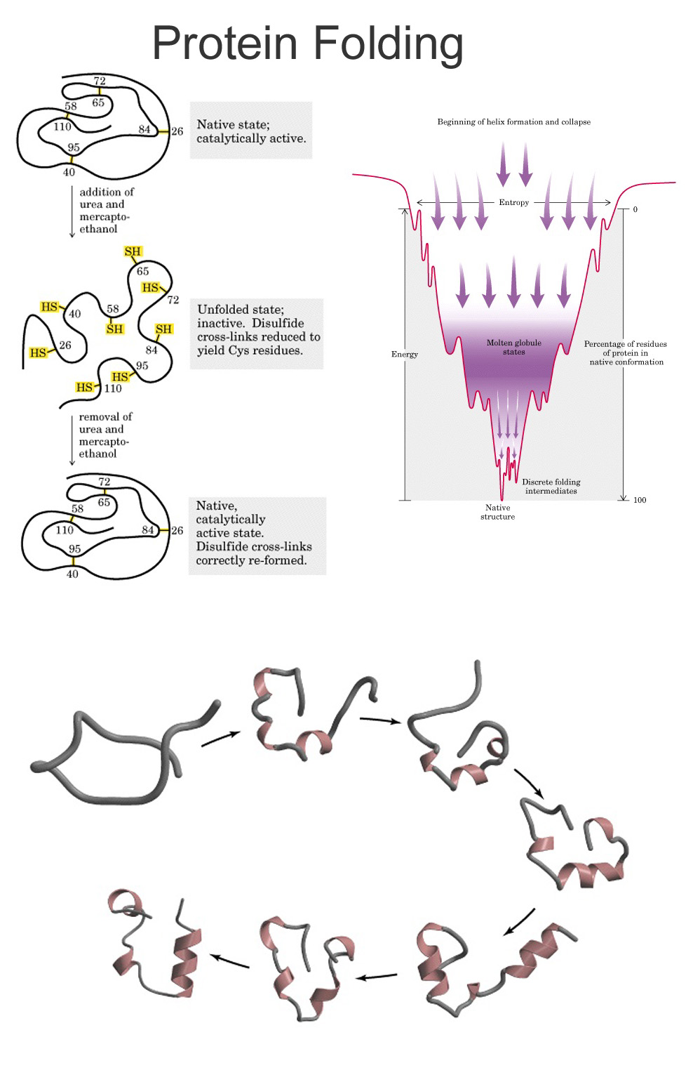
Protein Packing
Occurs in the cytosol (~60% bulk water, ~40% water of hydration)
Involves interaction between secondary structure elements and solvent
Yields tertiary structure

Slide 18
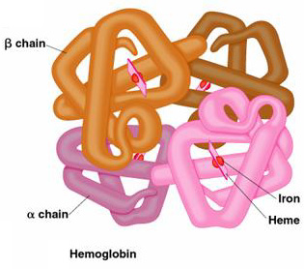
Quaternary Structure
Non-linear
3 dimensional
Involves the folding of globular proteins of 2 or more polypeptide chains
Example: Hemoglobin

Slide 19
Protein Interaction
Occurs in the cytosol, in close proximity to other folded and packed proteins
Involves interaction among tertiary structure elements of separate polymer chains

Slide 20
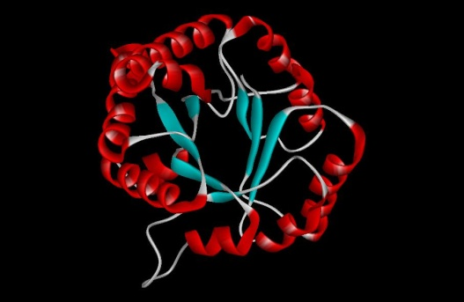
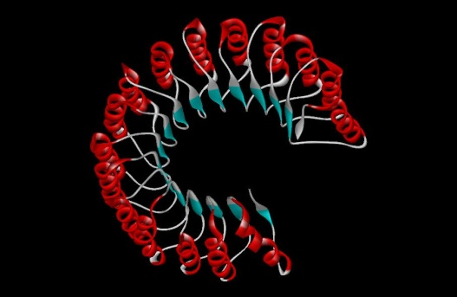
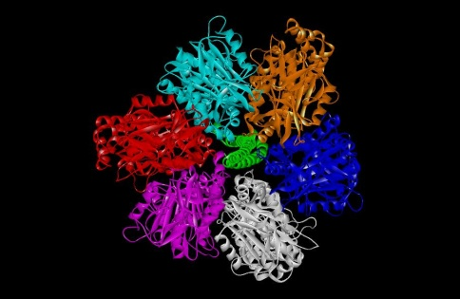
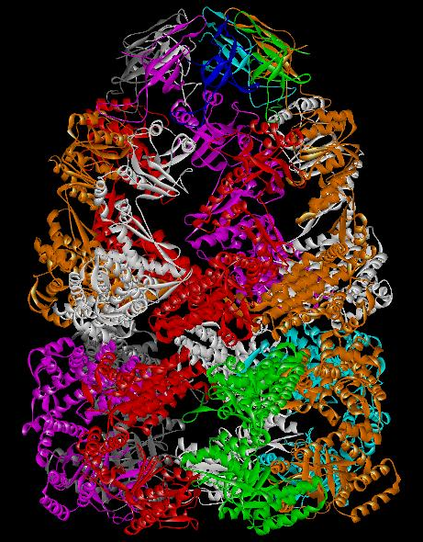
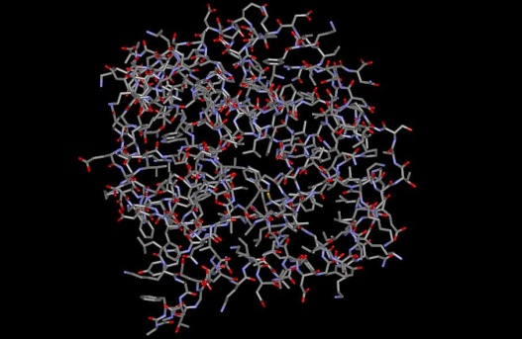
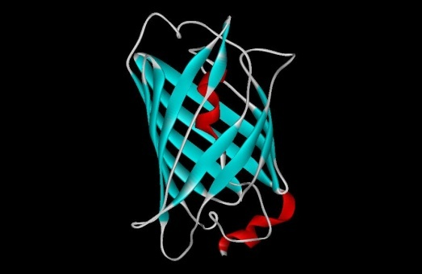
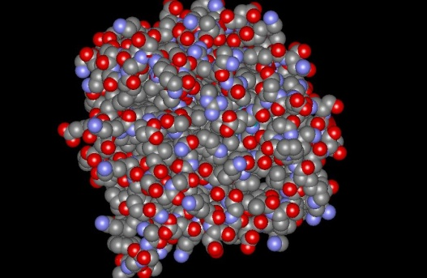
3D structure of proteins
Tertiary structure
Quaternary structure

Slide 21
FUNCTIONS OF PROTEINS
Proteins have range of essential functions in the body including : structural and dynamic functions:
Structural functions:
Required for building and repair of body tissues
Protein is a source of energy
Protein helps keep skin hair and nails healthy
Protein, like most other essential nutrients, is absolutely crucial for overall good health

Slide 22
DYNAMIC FUNCTIONS
Enzymes, hormones and immune molecules are proteins
Essential body processes such as water balancing, nutrient transport and muscle contractions require protein to function
Protein is a major element in transportation of certain molecules e.g. Hemoglobin is a protein that transports oxygen throughout the body
Protein forms antibodies that help prevent infection, illness and disease

Slide 23
THANK YOU

